Slide 1
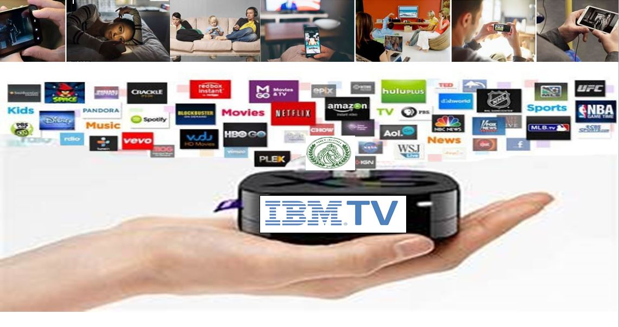
IBMTV.TV
International Broadcast Media TV Network
Broadcasting Across the Globe to 122 Countries
Advertising that fits your budget!
Sponsors and Advertising Kit

Slide 2
MEDIA INDUSTRY VALUE Broadens to WebTV and now PODTV
Research firm PwC anticipates revenue from media and entertainment will reach an estimated $2.6 trillion by 2023.
According to Nielsen Ratings, U.S. adults spend an average of 11 hours and 27 minutes per day connected to media.​
With Netflix reaching $15 billion in revenue in 2018, that still leaves $2.58 trillion left over.​
Look, this all may sound too good to be true, but the returns for “Netflix are Killer and have simply been too good to ignore – now is the time to take advantage of the shift in how the world is viewing content and expand into the webtv and take advertising to the next generation through IBMTV.TV PODTV platforms where advertising is cost effective and has a broader reach.

Slide 3
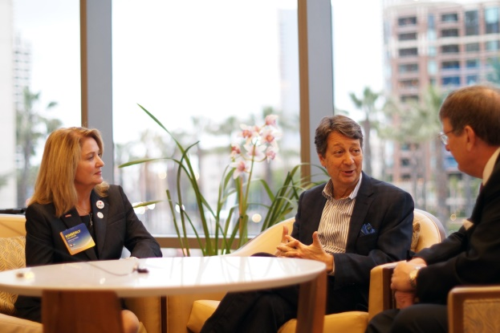
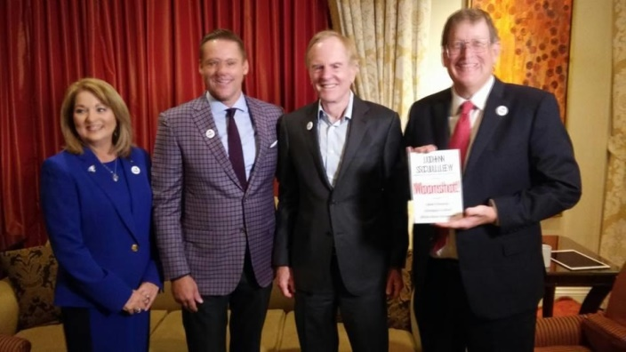
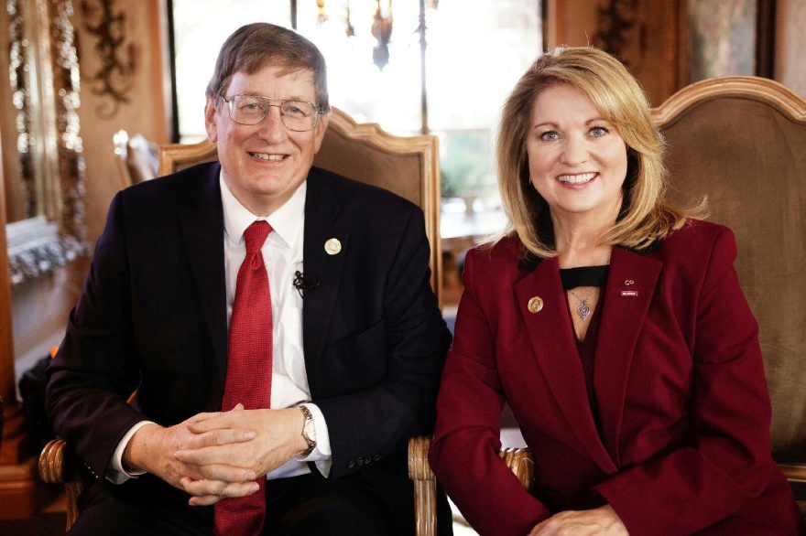
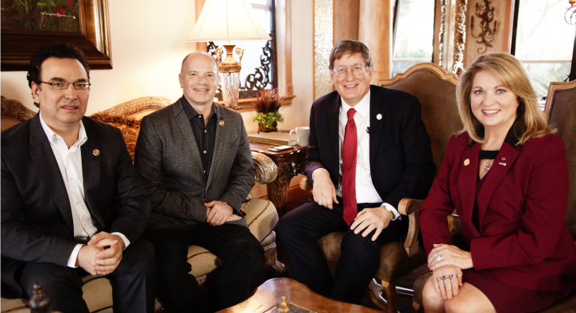
Our Exclusive Interviews have Included the
“A List Corporate Celebrities”
John Sculley,
former CEO of APPLE
Neil Shapiro, President of WYNET and former President of NBC
Be Our Guest!
Alan Treffler,
CEO of Pegas Systems - Billionaire
IBM IoT Team

Slide 4
IBMTV.TV Smart TV
4.3 Billion Viewer Reach-Worldwide!!!

Slide 5
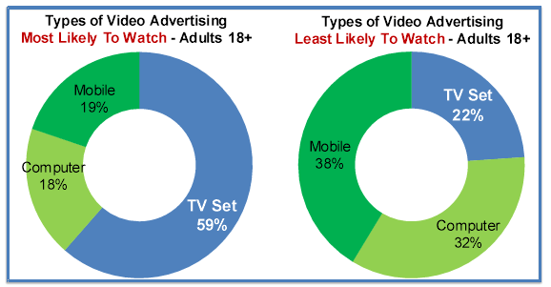
Advertising Stats
Highest Impact
On Line, Digital and Mobile has replaced traditional TV. Our Audience is Global.
Viewers pay the most attention to TV ads, finding them the most trusted, engaging, influential and effective.
TV generates 7x the return on investment of online, print and radio across multiple industries.

Slide 6
Major Global Events Broadcasting Live on IBMTV.TV
United Nations International Day of Peace
SIIA Summit – Multi-Billion Dollar funds Investing in companies around the World-Broadcasting (from Switzerland)
World Leaders Summit-90 countries, 133 speakers – event (from India)
American International Chamber of Commerce Annual Event over 450,000 members

Slide 7
Be Seen in 122 Countries Your Brand will Be Associated with Successful People Inspiring Sustainability
TV Shows you can be proud to be associated with and you want to be on: Producers and Host from around the world of every race, culture, color, age, gender, gender choice and disabled all sharing their stories and information.
IBMTV.TV brings Doctors, Lawyers, Scientist, Experts of various topics and industries who inspire healthier and wealthier lifestyles.
Family Value Educational Informational Healthy Entertainment and TV shows
Over 65 shows broadcasting over 122 countries
Broadcasting events who have over 450,000 members.

Slide 8
Some of Our Current TV Shows and adding more
Medical Friday with Dr. Saggu, Dr. Tula, Dr. Arnot and all doctors. around the world
Economic Mondays with David Cay Johnston, Dean from Yale Business school, Dean from University of Illinois and many other global business experts.
Travel Tuesday Café' with Brandon
Celebrity Tuesday with Henning Morales, Robert Kravitz, Wes Elder
Lawyers Den – Nick Paleveda and other Lawyers
China Travel with Vivian
Modern Investing with Sasha
Alexandra May Music Café
Chess Stars with Sasha Starr
Financial Friday with Marc and Frederick
Women Entrepreneurs with Scarlett Arana
Podcaster Thursdays
Video Gamers Den-Thursday
Spiritual Saturdays
Live music all weekend
Quality Children Shows
Gen-Z Teen Talk Show – Produced and Hosted by Teens
Radio Talk Show with Marc Lee
American Politics with Dr. Trezevant
White House Reports
Funk from Front Seat with Zack Roberson
IBM.TV Global News – Panel talks with medical and business experts from around the world sharing the Covid updates.
Money Rules with David Cay Johnston
Shoe Crazy Wine
Win with Win Charles –Women and Disability Empowerment
Mind Closet from Nigera
Talking Up Stream Unique TV show creating SuperHeros Live so viewers can join in.

Slide 9
Quality Programming Distribution Newer Technology providing better content and lowers the overhead
WEB TV BASE-with AR Technology!
Unique content for TECH and Financial
PODTV Platform (New)
Viewers can dial in and participate on shows
Cost effective to produce
Competitive air rates
Unique Quality Reality Video Content
International Network Broadcasted (Real TV)
Global Exposure - Global Board of Advisors
IBMTV.TV

Slide 10
Our TV Programs Inspire the 17 Sustainable Development Goals
We provide distribution for minority, disabled and underserved quality content

Slide 11
IBMTV. TV- Smart Television
“International Broadcast Media TV”
Nick Paleveda MBA J. D. LL.M an Adjunct Professor at Northeastern University and Kimberly Calhoun a Vice Chair on the Board of Advisors at North Carolina State University CSC are entrepreneurs. One legal, the other technical and both very financial. 2016 they met at a PBS Hack-a-thon while Nick was creating his new TV show MoneyMastersPBS TV to inspire financial literacy which aired Nationally.
They became partners then started a relationship with IBM using Watson in a series. During this time Nick legally acquired IBM.TV to start a global web-based network station where they distribute SMART TV cost effectively where viewers can engage and participate.
Nick and Kimberly were joined by Nguyen Phan PhD and Ankit Kandelwal from New Delhi India to create a Global Television Network with High Quality Educational, Inspirational, Informational and Entertaining Content inspiring global sustainability
In 6 months IBMTV.TV has become one of the top 2% in the world in Website views with 62 shows in 122 countries. We hit over 20K views per show with our recent promo model.
We provide the underserved, under privilege, minorities and disabled with quality content a means to distribute. No other network does this.
We have unique TV shows with “A” List Corporate Celebrities where no one wants to ever leave and they keep coming back each week.
Shows originate from India, South Africa, Malaysia, Nigeria and USA, Canada and Growing.
We are not owned by IBM or any Tech Company.

Slide 12
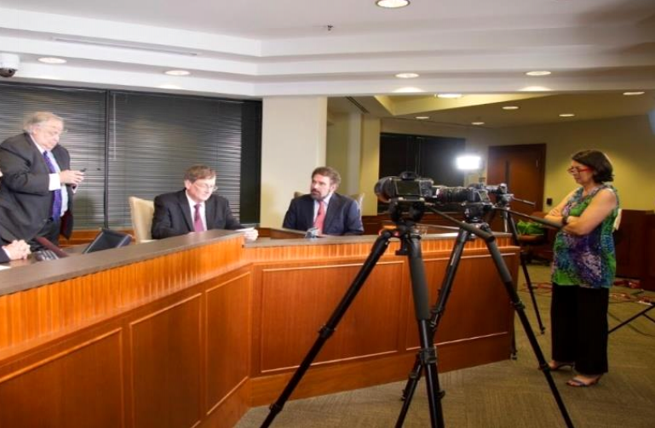
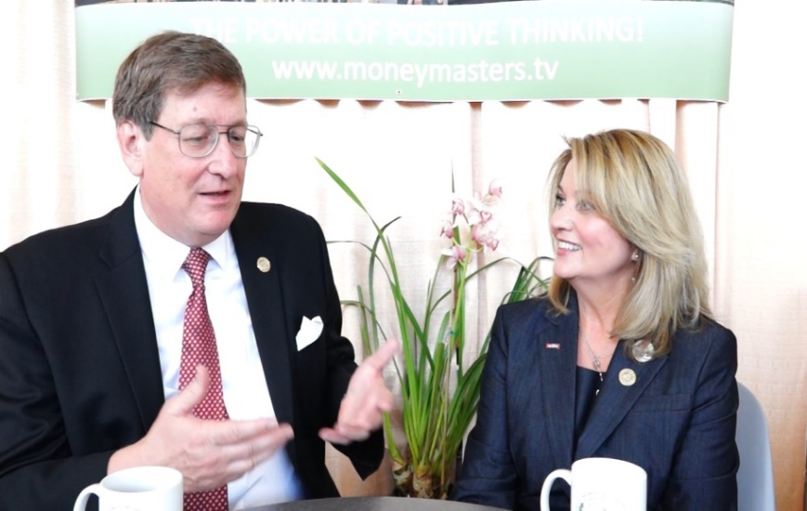
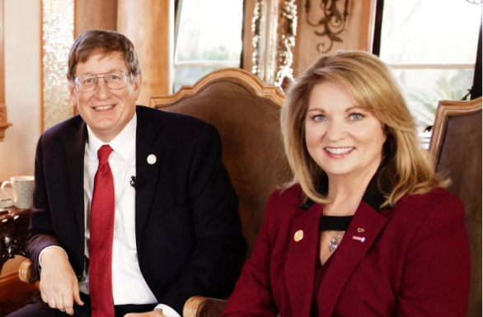
IBMTV.TV- SmartTV - The Quality of TV
Problems:
Quality Content –Family values, creditability and education.
2. TV Network Distribution for Minority and disabled content providers.
3. TV exposure for Global Events.
Solution:
IBMTV policies are the content must be clean, family value, no profanity or porn. It must be educational, informational and Inspirational from creditable resources We are diverse and inclusive organization providing economical access for distribution of quality content for everyone including minorities and disabled. We have a unique business model where we coach and innovate providers on how to monetize their business and TV shows. This healthy mindset becomes contagious.

Slide 13
“Great American Adventure” in 180 Days New Travel show with Branden Scott
GET READY TO TRAVEL! GET YOUR MAPS, Mobile Devices and GPS TRACKERS.
Even during a Pandemic, even from your recliner, see the Great America views.
This is a real life engaging virtual experience. While Branden travels cross cross country in his RV, his Fans can watch, text and maybe even meet him at his next locations for a campfire visit.
Reawakening our Travel Spirit, Branden will travel across the US in a RV wrapped with Advertisements and Sponsors inspiring ways we can travel and experience the world again.
Branden will provide us uniquely “Edutaining” dialogue, beautiful visuals of hot spots with a lot of reality entertainment with daily live updates and who knows what kind of trouble we will run into, “It’s LIVE”.
180 day road trip with daily live entertainment and creates 24 fully produced TV shows.
Learn how to plan and prepare your next road trip with cost effective tips to see our native land.
Brandon will provide the virtual experience for those of us who can not risk traveling now.
Branden - I80 Days Livestream Across America

Slide 14
“Economics Monday” A show no one wants to ever leave
Imagine a 4 hour talk show where the conversation is so powerful people never want to leave and it is about financial topics! The viewership expanded over 1000% the first month from all over the world. This spell bounding educational experience was created by Ankit Kandelwal, Nick Paleveda and Kimberly Calhoun.
March 7, 2020, when Covid Pandemic closed the world down, experts from all over the world have joined us live to discuss the state of affairs and how we can over come the crisis. Conversations with billionaires, doctors, the former US Comptroller General, famous book authors, senators, dignitaries and Deans from great universities, all in one room at one time. We not only have these conversations, we open them up to the pubic and viewers to engage and text questions. We have united global conversations with brilliant discussions and we have a lot of laughs too.
Brilliant Minds Around the World Unite

Slide 15
Lawyers Den
Move over Judge Judy!-The Lawyer’s Den takes on MORE hard issues than someone who did not pay rent-from Roe v Wade to Sexual Harassment cases to Gun laws-everything before the Court comes to the Den with REAL Lawyers examining the issues in a REAL debate!
Monday-Thursday 7-8pm EST

Slide 16
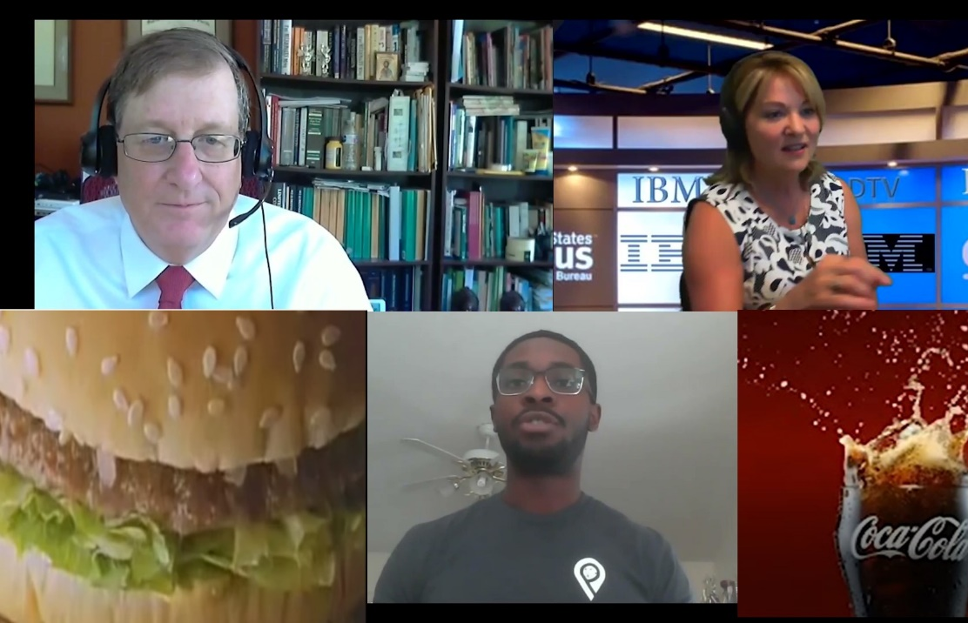
Proof of Concept Test with Silent Ads Proved Powerful Persuasion. 100% audience got a coke and burger after show
PODTV with easy billboard ads

Slide 17
Contact
Thank you for your time!
We have advertising that will fit your budget!
Contact:
Kimberly Calhoun
Kimberly@ibmtv.tv 919-673-0612
www.ibmtv.tv

